Slide 1

Team Venom

Slide 2
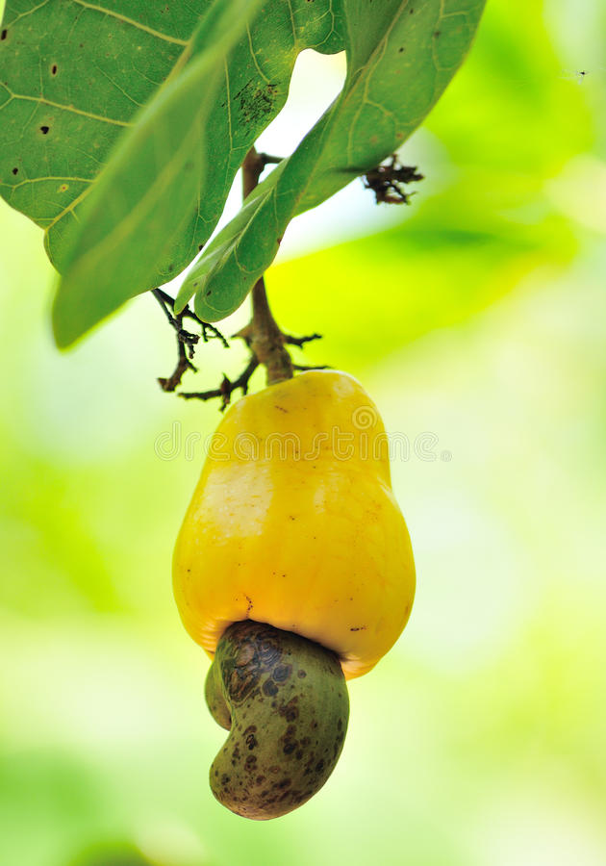

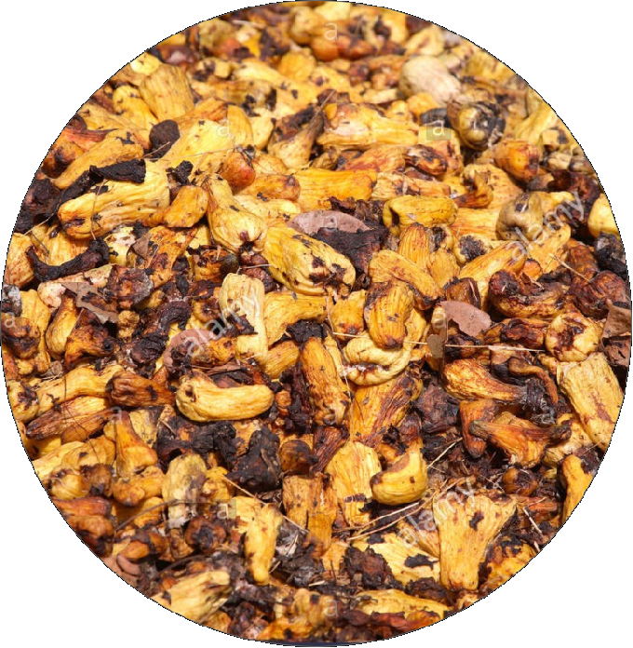

PROBLEM STATMENT
The lack of utilization of cashew apple

Slide 3

SOLUTION
We will buy these apples from farmers
Cashew Apples
Pressing
Cashew Juice
fermentation
filteration
fiteration
packaging
distilation
packaging

Slide 4

ENTER TITLE
ENTER TITLE
add you text here add you text
add you text here add you text

Slide 5
Marketing Strategy
Social Media Campaign
Promotional discounts
Face to face marketing
The use of Leads
Radio talk show

Slide 6




OUR COMPETITIVE ADVANTAGE
market info
partner
online market
made in Ghana
Web app
Mobile app
Local
Breweries

Slide 7
OUR ASK
We need GH¢ 65,000.00 from investors, 21% of our profits for the next 10 years will be given as interest to any willing to invest in us.
Expenses:
Equipment for production include fruit crusher, filter, distillery, packaging
(¢43,700) 67.2%
Fair fees, publicity and transportation costs (¢18,300)28.1%
Inventory space for products(¢3,000)
4.6%

Slide 8

REVENUE MODEL
Paid advertisement on our platforms.
Transactional fees charged on orders.
Commission on products purchased.

Slide 9








IMPACT

Slide 10
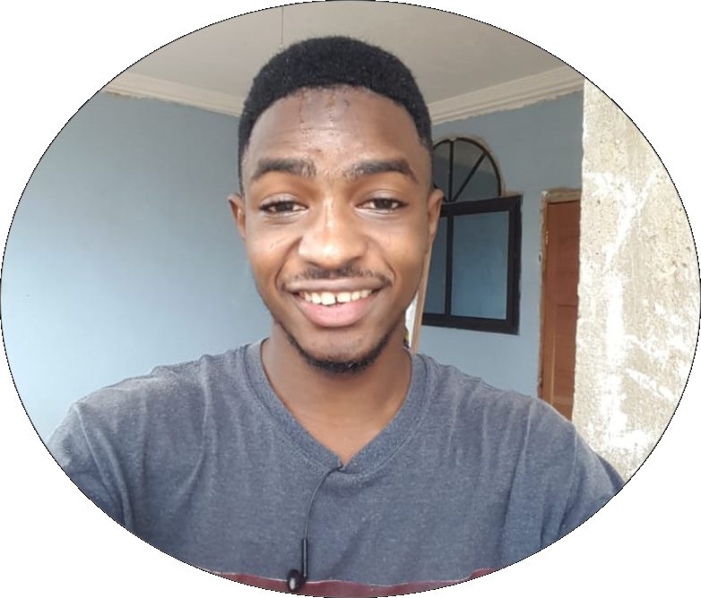
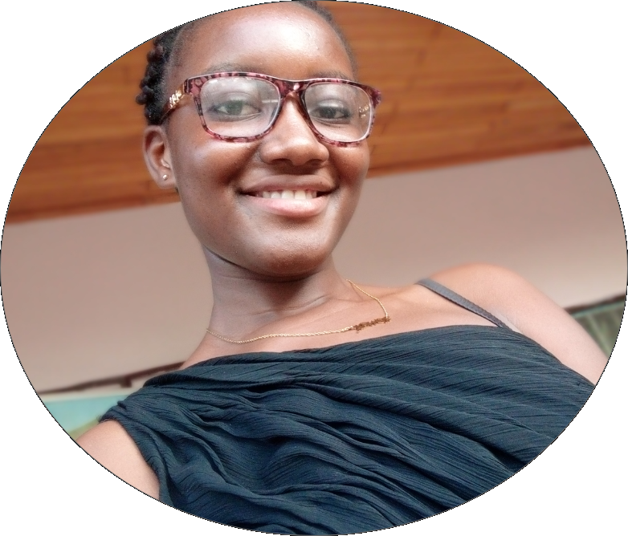
TEAM
Baah Tonkouru David
Co-Founder
Priscilla Kyeremaah
Co-Founder
Technical Supervisor
Marketing Manager

Slide 11





PARTNERS

Slide 12
THANK YOU

